Slide 1
GRAPHS
Depth-First Search 2/2
by
Lilian Blot
Notes:
In this video, we will be looking at another implementation of the Depth-First Search traversal.

Slide 2

Iterative approach
Notes:
In the previous video of the Graphs series, we have seen the backtracking implementation using recursion. There is an alternative implementation of the Depth-First search algorithm that does not involve recursion.

Slide 3
An iterative approach to DFS can be done via a stack. The stack is used to store the discovered nodes, not the visited ones. In fact, the stack emulates the call stack of a recursive function.
1
3
6
0
4
2
Unvisited
8
7
5
Stack
Notes:
An iterative approach to DFS can be done via a stack. The stack is used to store the discovered nodes, not the visited ones. The visited nodes can be recorded via a set or an array. In fact, the stack emulates the call stack of a recursive function.

Slide 4
1
3
6
0
4
2
Unvisited
8
To process
7
0
5
Stack
Notes:
The first step of the algorithm is to choose a starting node. Again, it does not matter which one you are choosing. In our case, we start at vertex 0 and we push it to the stack.
Next we pop the vertex at the top of the stack, currently vertex 0.

Slide 5
1
3
6
0
4
2
Unvisited
8
To process
7
Being processed
5
Stack
Notes:
From vertex 0, we explore all the outgoing edges that have not yet been used. The first edge is for example edge (0,2).

Slide 6
1
3
6
0
4
2
Unvisited
8
To process
7
2
Being processed
5
Stack
Notes:
The node 2 is unvisited and we push it to the stack. There is another unvisited outgoing edge from 0, so we are not done yet with vertex 0.

Slide 7
1
3
6
0
4
2
Unvisited
8
1
To process
7
2
Being processed
5
Stack
Notes:
We must explore edge (0,1).Vertex 1 is not visited so we push it to the stack. There are no more edge to explore from vertex 0, so it is labelled as processed.

Slide 8
1
3
6
0
4
2
Unvisited
8
1
To process
7
2
Being processed
5
Stack
Processed
Notes:
Now we can pop the element at the top of the stack and we processed it.

Slide 9
1
3
6
0
4
2
Unvisited
8
To process
7
2
Being processed
5
Stack
Processed
Notes:
Vertex 1 is the node we need to explore next. First we look at edge from 1 to 2.

Slide 10
1
3
6
0
4
2
Unvisited
8
To process
7
2
Being processed
5
Stack
Processed
Notes:
Vertex 2 has already been visited, so we move to the next edge, in this case the edge from 1 to 3. Vertex 3 is unvisited so we push it to the top of the stack.

Slide 11
1
3
6
0
4
2
Unvisited
8
3
To process
7
2
Being processed
5
Stack
Processed
Notes:
We are done with vertex 1 and it is labelled as processed. Next we pop the vertex at the top of the stack, that is vertex 3.

Slide 12
1
3
6
0
4
2
Unvisited
8
To process
7
2
Being processed
5
Stack
Processed
Notes:
We keep adding the unvisited nodes we discover at the top of the stack, and pop the element from the top of the stack when a node has been fully processed. We do so until the stack is empty.

Slide 13
1
3
6
0
4
2
Unvisited
8
4
To process
7
2
Being processed
5
Stack
Processed

Slide 14
1
3
6
0
4
2
Unvisited
8
To process
7
2
Being processed
5
Stack
Processed

Slide 15
1
3
6
0
4
2
Unvisited
8
To process
7
2
Being processed
5
Stack
Processed

Slide 16
1
3
6
0
4
2
Unvisited
8
7
To process
7
2
Being processed
5
Stack
Processed

Slide 17
1
3
6
0
4
2
6
Unvisited
8
7
To process
7
2
Being processed
5
Stack
Processed

Slide 18
1
3
6
0
4
2
6
Unvisited
8
7
To process
7
2
Being processed
5
Stack
Processed

Slide 19
1
3
6
0
4
2
Unvisited
8
7
To process
7
2
Being processed
5
Stack
Processed

Slide 20
1
3
6
0
4
2
Unvisited
8
7
To process
7
2
Being processed
5
Stack
Processed

Slide 21
1
3
6
0
4
2
Unvisited
8
7
To process
7
2
Being processed
5
Stack
Processed

Slide 22
1
3
6
0
4
2
Unvisited
8
To process
7
2
Being processed
5
Stack
Processed

Slide 23
1
3
6
0
4
2
Unvisited
8
8
To process
7
2
Being processed
5
Stack
Processed

Slide 24
1
3
6
0
4
2
Unvisited
8
8
To process
7
2
Being processed
5
Stack
Processed

Slide 25
1
3
6
0
4
2
Unvisited
8
To process
7
2
Being processed
5
Stack
Processed

Slide 26
1
3
6
0
4
2
Unvisited
8
To process
7
2
Being processed
5
Stack
Processed
Notes:
Now we have to pop the last element of the stack and process it.

Slide 27
1
3
6
0
4
2
Unvisited
8
To process
7
Being processed
5
Stack
Processed
Notes:
The stack is empty, however we still have to explore the remaining outgoing edges from 2 that have not yet been explored. We are not finished yet. From vertex 2, there is only one edge left to explore, the edge from 2 to 5.

Slide 28
1
3
6
0
4
2
Unvisited
8
To process
7
5
Being processed
5
Stack
Processed
Notes:
Vertex 5 is unvisited, so we push it to the stack.

Slide 29
1
3
6
0
4
2
Unvisited
8
To process
7
5
Being processed
5
Stack
Processed
Notes:
We are done with vertex 2, and we pop the element at the top of the stack.

Slide 30
1
3
6
0
4
2
Unvisited
8
To process
7
Being processed
5
Stack
Processed
Notes:
Vertex 5 has no unvisited outgoing edge, so it is a dead end.

Slide 31
1
3
6
0
4
2
Unvisited
8
To process
7
Being processed
5
Stack
Processed
Notes:
The stack is now empty, and we don’t have any vertices being processed. We have finished our Breadth-First Search traversal.

Slide 32
Algorithm
1 Procedure (G : Graph, Source : Vertex)
2 beingVisited := empty stack
3 beingVisited.push(source)
4 visited :=[false, …, false] // size |V|
5 visited[Source] := true
5 while beingVisited not empty do
6 current := beingVisited.pop()
7 Process(current) // for example print
8 for next in current.neighbours() do
9 if not visited[next] then
10 beingVisited.push(next)
11 visited[next] := true
12 end if
13 end for
14 end while
Notes:
The next step is to write the pseudo-code for the iterative implementation of the Depth-First search traversal.

Slide 33
Algorithm
1 Procedure Search(G : Graph, Source : Vertex)
2 beingVisited := empty stack
3 beingVisited.push(source)
4 visited :=[false, …, false] // size |V|
5 visited[Source] := true
5 while beingVisited not empty do
6 current := beingVisited.pop()
7 Process(current) // for example print
8 for next in current.neighbours() do
9 if not visited[next] then
10 beingVisited.push(next)
11 visited[next] := true
12 end if
13 end for
14 end while
Notes:
The procedure takes two inputs, the graph to be traversed and “Source” the starting vertex for the exploration of the graph.

Slide 34
Algorithm
1 Procedure Search(G : Graph, Source : Vertex)
2 beingVisited := empty stack
3 beingVisited.push(source)
4 visited :=[false, …, false] // size |V|
5 visited[Source] := true
5 while beingVisited not empty do
6 current := beingVisited.pop()
7 Process(current) // for example print
8 for next in current.neighbours() do
9 if not visited[next] then
10 beingVisited.push(next)
11 visited[next] := true
12 end if
13 end for
14 end while
Notes:
Before starting the exploration, we need to set up some containers, a stack to store the vertex being visited, and an array labelling vertices as visited or not. First let’s set up the stack “beingVisited” to an empty stack and then push to the top of the stack the starting vertex “Source”.

Slide 35
Algorithm
1 Procedure Search(G : Graph, Source : Vertex)
2 beingVisited := empty stack
3 beingVisited.push(source)
4 visited :=[false, …, false] // size |V|
5 visited[Source] := true
5 while beingVisited not empty do
6 current := beingVisited.pop()
7 Process(current) // for example print
8 for next in current.neighbours() do
9 if not visited[next] then
10 beingVisited.push(next)
11 visited[next] := true
12 end if
13 end for
14 end while
Notes:
Secondly, let’s set up an array of size V, the number of vertices in the graph, initialise to false. False means the vertex has not been visited. AS we have added Source to the stack, we can label the vertex Source as visited.

Slide 36
Algorithm
1 Procedure Search(G : Graph, Source : Vertex)
2 beingVisited := empty stack
3 beingVisited.push(source)
4 visited :=[false, …, false] // size |V|
5 visited[Source] := true
5 while beingVisited not empty do
6 current := beingVisited.pop()
7 Process(current) // for example print
8 for next in current.neighbours() do
9 if not visited[next] then
10 beingVisited.push(next)
11 visited[next] := true
12 end if
13 end for
14 end while
Notes:
Now the set up is done, we can move on to the main body of the algorithm. While the stack is not empty, we need to do the following:

Slide 37
Algorithm
1 Procedure Search(G : Graph, Source : Vertex)
2 beingVisited := empty stack
3 beingVisited.push(source)
4 visited :=[false, …, false] // size |V|
5 visited[Source] := true
5 while beingVisited not empty do
6 current := beingVisited.pop()
7 Process(current) // for example print
8 for next in current.neighbours() do
9 if not visited[next] then
10 beingVisited.push(next)
11 visited[next] := true
12 end if
13 end for
14 end while
Notes:
Take the vertex at the top of the stack

Slide 38
Algorithm
1 Procedure Search(G : Graph, Source : Vertex)
2 beingVisited := empty stack
3 beingVisited.push(source)
4 visited :=[false, …, false] // size |V|
5 visited[Source] := true
5 while beingVisited not empty do
6 current := beingVisited.pop()
7 Process(current) // for example print
8 for next in current.neighbours() do
9 if not visited[next] then
10 beingVisited.push(next)
11 visited[next] := true
12 end if
13 end for
14 end while
Notes:
And process it, for example just printing its value.

Slide 39
Algorithm
1 Procedure Search(G : Graph, Source : Vertex)
2 beingVisited := empty stack
3 beingVisited.push(source)
4 visited :=[false, …, false] // size |V|
5 visited[Source] := true
5 while beingVisited not empty do
6 current := beingVisited.pop()
7 Process(current) // for example print
8 for next in current.neighbours() do
9 if not visited[next] then
10 beingVisited.push(next)
11 visited[next] := true
12 end if
13 end for
14 end while
current.neighbours() returns the outgoing vertices of the vertex current.
Notes:
Once processed, we look at all its neighbours one by one.

Slide 40
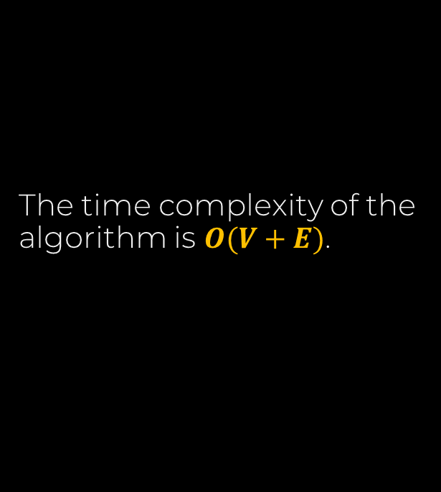
Algorithm
1 Procedure Search(G : Graph, Source : Vertex)
2 beingVisited := empty stack
3 beingVisited.push(source)
4 visited :=[false, …, false] // size |V|
5 visited[Source] := true
5 while beingVisited not empty do
6 current := beingVisited.pop()
7 Process(current) // for example print
8 for next in current.neighbours() do
9 if not visited[next] then
10 beingVisited.push(next)
11 visited[next] := true
12 end if
13 end for
14 end while
The time complexity of the algorithm is $O(V+E)$.
Notes:
If a neighbour has already been visited, that is it is in the stack or we have processed all its neighbours, then ignore it, otherwise add the neighbour to the stack, and label it as visited.
The time complexity of this algorithm is the same as the one using recursion, and again using an adjacency list representation on a sparse graph would result in better performance than using an adjacency matrix.

Slide 41
DFS has many applications for solving problems for both directed and undirected graphs.
There is another alternative to the Depth-First Search traversal of a graph, the Breadth-First Search (BFS). This approach also has many application for solving other types of graph problems.
Notes:
DFS has many applications for solving problems for both directed and undirected graphs. We will be exploring some of them at a later stage.
There is another alternative to the Depth-First Search traversal of a graph, the Breadth-First Search (BFS). This approach also has many application for solving other types of graph problems and it will be the subject of another video.

